Slide 1
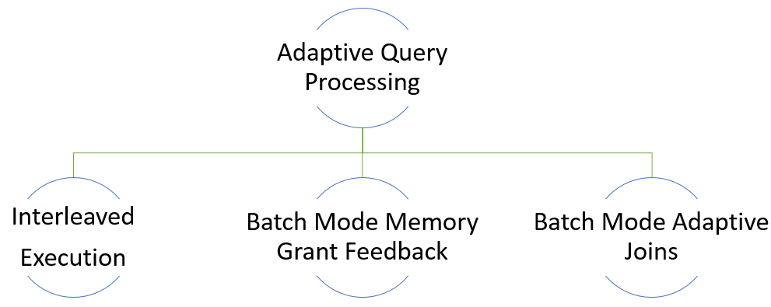
Adaptive Query Processing Feature Family
Notes:
Interleaved – Table Valued Function
Batch Mode Memory Grant– Query Grant, same procedure generating lot of output
Batch Mode Adaptive – Intelligent way of choosing Hash Match or Inner Loop
Explained through example below
Talk about Query Optimization, Plan Caching.. etc

Slide 2
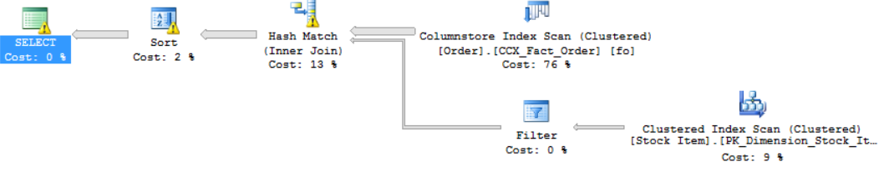
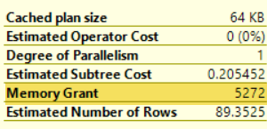
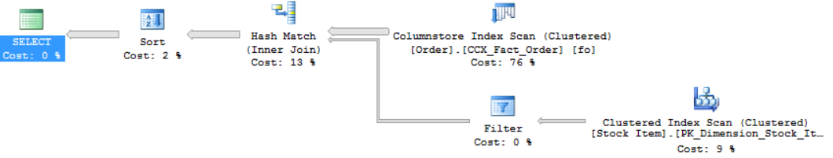
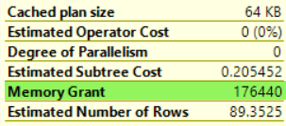
Batch Mode Memory Grant Feedback
Before
Spill
Spill
Spill detected
and feedback generated
After

Slide 3
Resumable Online Index Rebuild
Available only for online index rebuild
Allows you to
Resume an index rebuild operation after a rebuild failure
Pause a resumable index rebuild, and resume later
Abort a paused or running resumable online index rebuild operation
Specify maximum duration for a resumable online index rebuild operation
Rebuild large indexes in stages

Slide 4
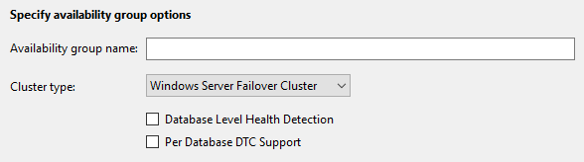
Distributed Transactions
Support option available in GUI
DTC support for availability databases:
In the same instance
In different instances
Notes:
https://docs.microsoft.com/en-us/sql/database-engine/availability-groups/windows/transactions-always-on-availability-and-database-mirroring
In SQL Server 2016 and older versions, cross-database transactions for availability databases are supported as long as no two databases in a cross-database transaction are in the same instance. This also means that cross-database transactions are not supported if databases in the distributed transaction are in the same availability group. In SQL Server 2017, support for distributed transactions on availability databases includes databases in the same instance of SQL Server, or in different instances.

Slide 5
Cluster Type
Specifies the type of server cluster manager
Available cluster types:
WSFC: Windows Server Failover Cluster
EXTERNAL: Non-Windows server cluster manager such as Linux Pacemaker
NONE: No cluster manager
Used to create cluster-less availability groups
Provides read-scale
Not intended for high availability
Manual failover only
Notes:
CLUSTER_TYPE is a parameter that specifies the type of server cluster manager that manages an availability group.
WSFC is the default setting in a Windows cluster.
EXTERNAL is used to set up availability groups in Linux with Pacemaker.
Use NONE when you don’t want the availability group to use a cluster manager, such as WSFC in Windows, or Pacemaker on Linux

Slide 6
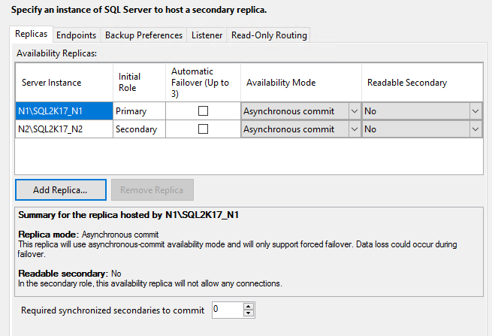
Minimum Replica Commit

Slide 7
Automatic Tuning
Database feature providing insight into potential query performance problems and recommends solutions.
Detects regressed plans and applies last known good plan if difference in performance is high enough.
Notes:
Automatic tuning in SQL Server 2017 notifies you whenever a potential performance issue is detected, and lets you apply corrective actions, or lets the Database Engine automatically fix performance problems. Automatic tuning in SQL Server 2017 enables you to identify and fix performance issues caused by SQL plan choice regressions.
Leverages Query store introduced in SQL server 2016

Slide 8
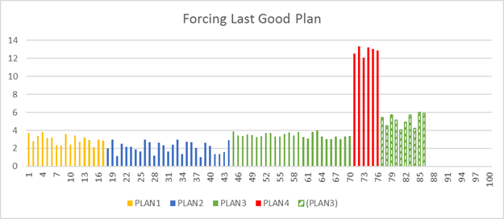
Automatic Plan Correction
Automatically apply the mitigation identified in sys.dm_db_tuning_recommendations by enabling the AUTOMATIC_TUNING database property:
ALTER DATABASE current
SET AUTOMATIC_TUNING ( FORCE_LAST_GOOD_PLAN = ON );
Notes:
Source: https://docs.microsoft.com/en-us/sql/relational-databases/automatic-tuning/automatic-tuning#automatic-plan-correction
In addition to detection, the Database Engine can automatically switch to the last known good plan whenever the regression is detected.
When the Database Engine applies a recommendation, it automatically monitors the performance of the forced plan. The forced plan will be retained until a recompile (for example, on next statistics or schema change) if that is better than the regressed plan. If the forced plan is not better than the regressed plan, the new plan will be unforced and the Database Engine will compile a new plan.
Enabling automatic plan choice correction
The user can enable automatic tuning per database and specify that the last good plan should be forced whenever some plan change regression is detected. Automatic tuning is enabled using the following command:
ALTER DATABASE current SET AUTOMATIC_TUNING ( FORCE_LAST_GOOD_PLAN = ON );
When you turn on this option, Database Engine will automatically force any recommendation where the estimated CPU gain is higher than 10 seconds, or the number of errors in the new plan is higher than the number of errors in the recommended plan—and verify that the forced plan is better than the current one.

Slide 9


SQL Server Supported Platforms
SUSE Enterprise Linux (SLES) v12 SP2
RedHat Enterprise Linux (RHEL) 7.4
Ubuntu 16.04, 16.10
Possibly other Linux distributions in the future
Docker: Windows & Linux containers
Windows Server / Windows 10
Linux
Containers
Windows
Windows Server

Slide 10
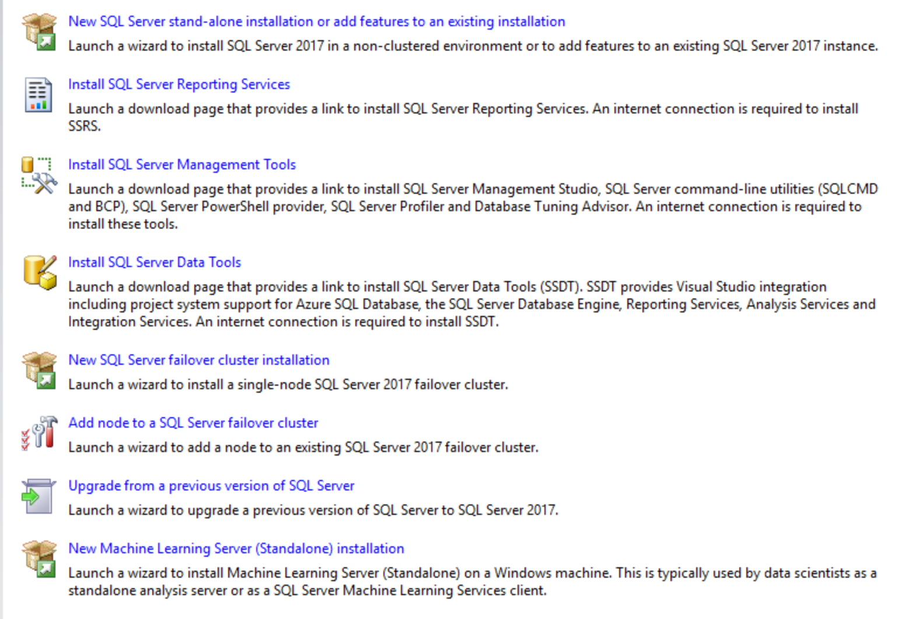
Installation Changes
SQL Server 2017
install
SSRS is now a separate install
Machine Learning is now a separate install and also available in the Engine Install
Installation
Notes:
SSRS is now a separate install..
Most customers might expect it to be part of the SQL Engine but is a change in order to allow for quicker updates. If they download and install separately, they may need to capture their license key from a production installation (unless they are installing developer edition) since the download does not come from the volume licensing site.
Machine learning (standalone) can be installed from the SQL ISO as well. This is not the same as Machine Learning (in-database) which is a feature option in the SQL Server installation.

Slide 11
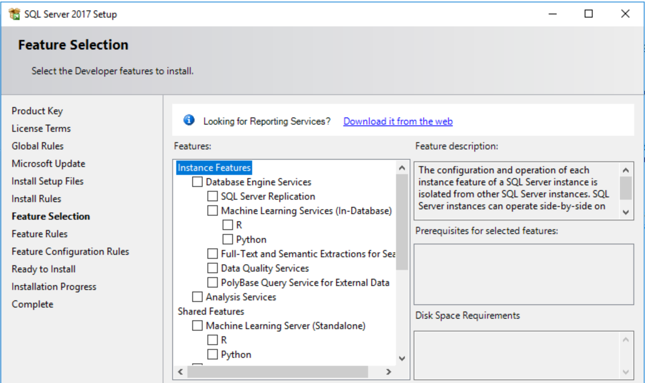
SSRS – Setup
SQL Server 2017
At the Instance Selection, you have a separate option to install SSRS
Installation
Notes:
You can still use the Engine to install SSRS. But requires Internet Connection

Slide 12
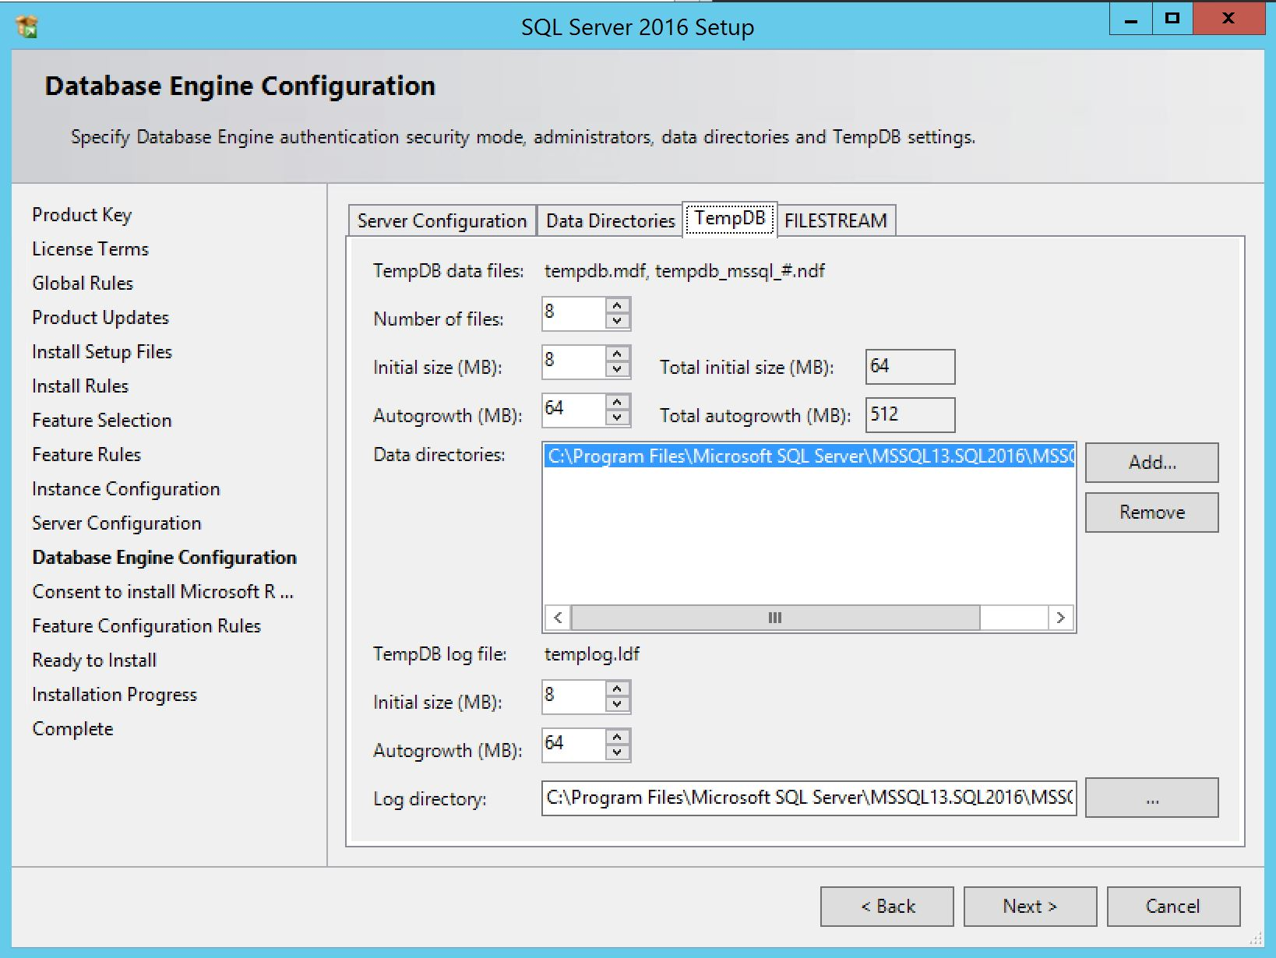
TempDB – Setup
initial tempdb file size up to 256 GB
Installation
Notes:
Setup now allows specifying initial tempdb file size up to 256 GB (262,144 MB) per file, with a warning if the file size is set greater than 1GB with IFI not enabled.
https://blogs.technet.microsoft.com/dataplatforminsider/2017/04/28/sql-server-community-driven-enhancements-in-sql-server-2017/
Other features are from SQL 2016 Installation and not highlighted on this slide

Slide 13
SQL Server 2017 Expands Query Store
Wait Statistics now available
Locks
Latches
Memory
I/O
Network
HADR
“What queries are blocked the most?”
“What queries wait most on LOCKs?”
“For my most expensive queries, how much time are they running vs waiting?”

Slide 14
What is a Graph Database?
A collection of nodes and edges
A node represents an entity such as a person, airport, or organization
An edge represents a relationship between nodes
Nodes and edges are stored as tables
New SQL syntax
Familiar tools and eco-system
Notes:
https://docs.microsoft.com/en-us/sql/relational-databases/graphs/sql-graph-overview

Slide 15
Graph Database Support
DDL Extensions:
Create Node and Edge Tables
Node and Edge tables can have properties associated with them represented as additional user defined columns.
-- Create friend node table
CREATE TABLE dbo.friend (ID integer PRIMARY KEY, name varchar(50)) AS NODE;
-- Create friendof edge table
CREATE TABLE dbo.friendof AS EDGE;
Metadata:
SYS.TABLES contains new columns, is_node and is_edge. If is_node is set to 1 that table is a node table. If is_edge is set to 1 then that table is an edge table.
SYS.COLUMNS contains new columns, graph_type and graph_type_desc. These will indicate the type of column in node and edge tables.
Notes:
https://docs.microsoft.com/en-us/sql/relational-databases/graphs/sql-graph-architecture

Slide 16
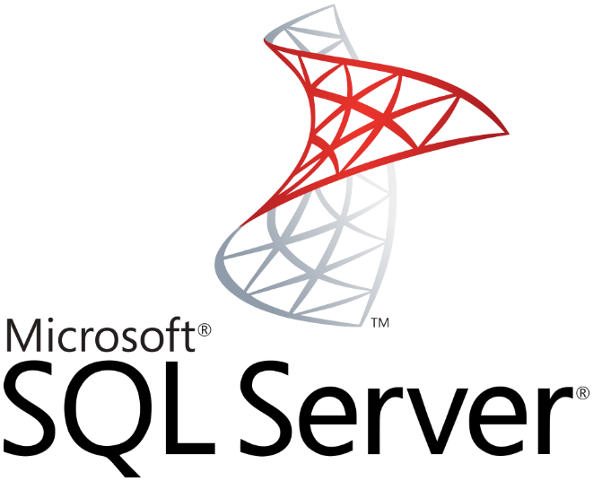

Why SQL Server Machine Learning Services?
R Services (In-Database) - 2016 Machine Learning Services (In-Database) - 2017
In-Database Analytics
Familiar
Scalable
Secure
T-SQL
SQLOS
DMVs
Resource Governor
XEvent
Query Store
LOG files
Seconds and ms
R Open
R Client (R Studio)
ScaleR
Python
Anaconda
PyCharm and PyDev
Hours and Days
New to all of this? Step by Step
SQL Server & Microsoft R & Python

Slide 17
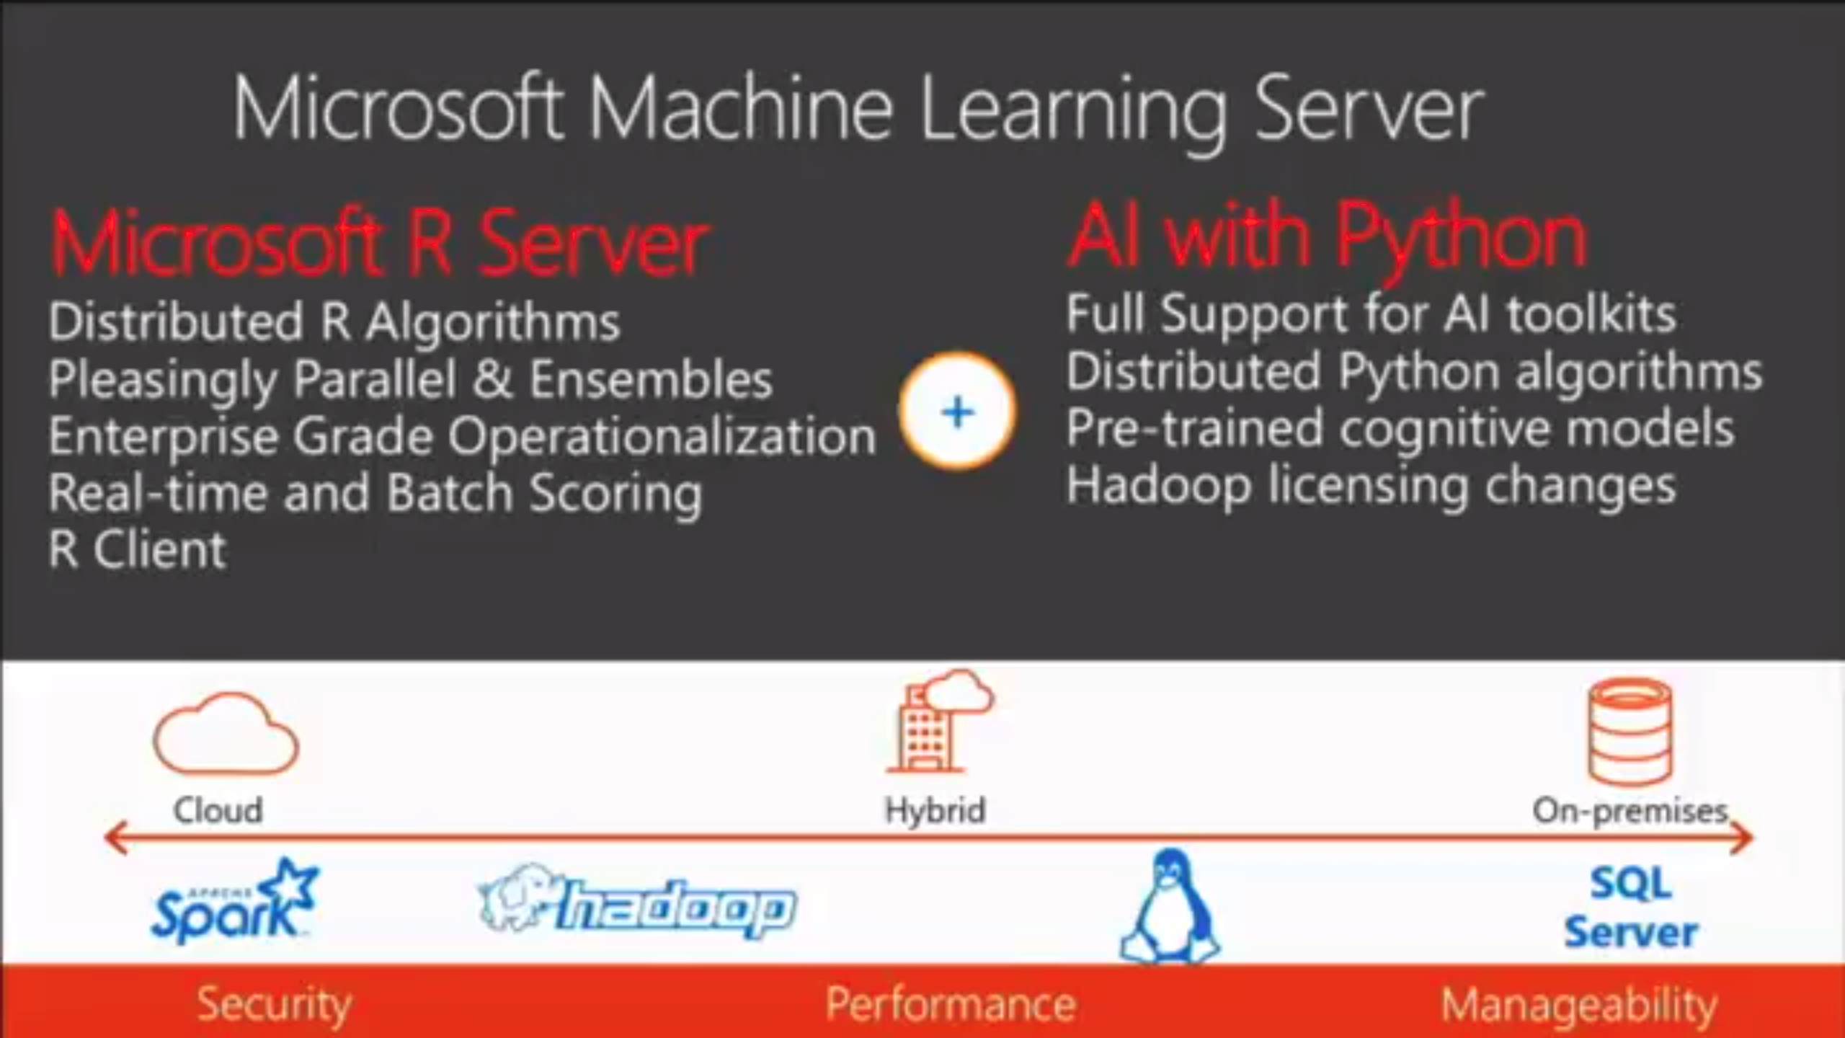

Slide 18
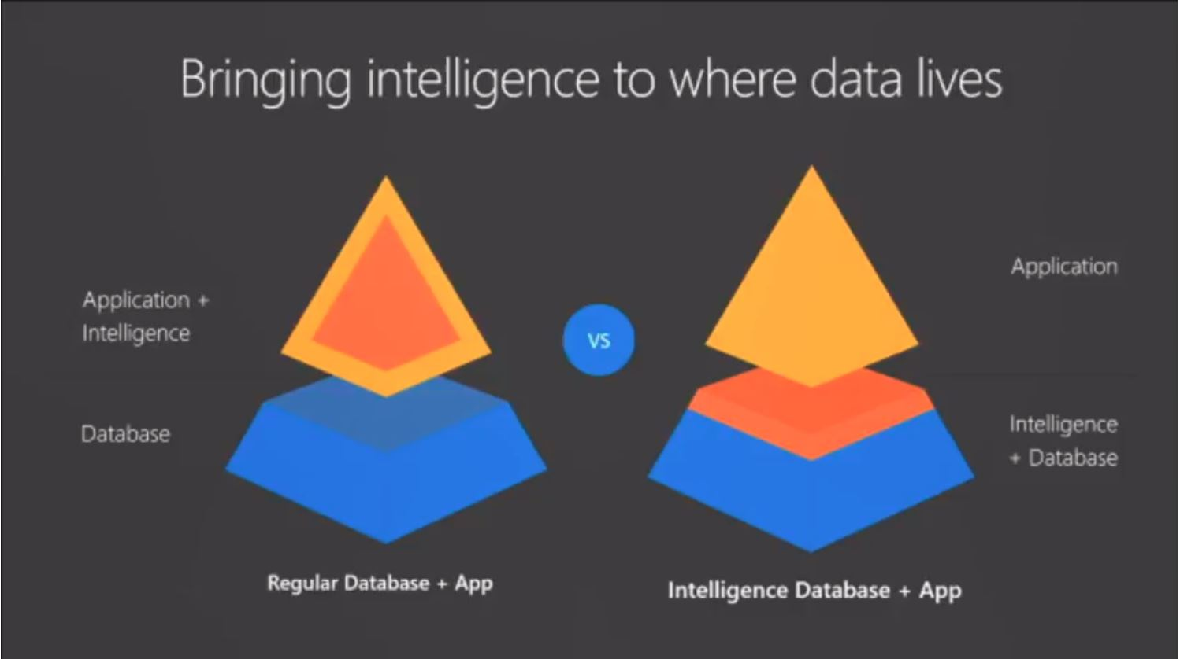

Slide 19
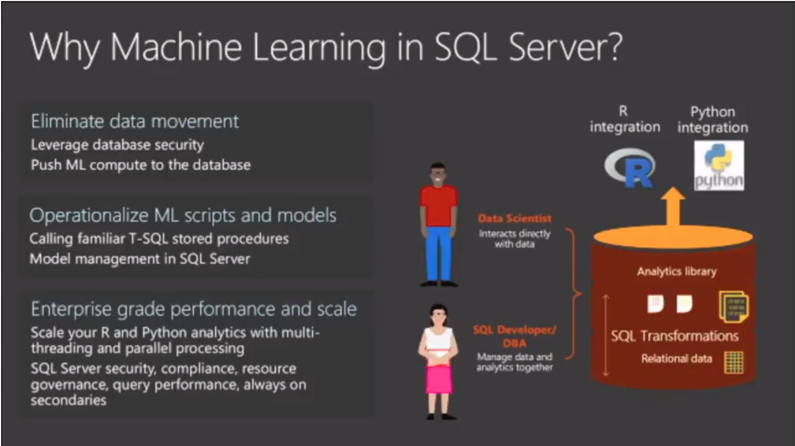

Slide 20
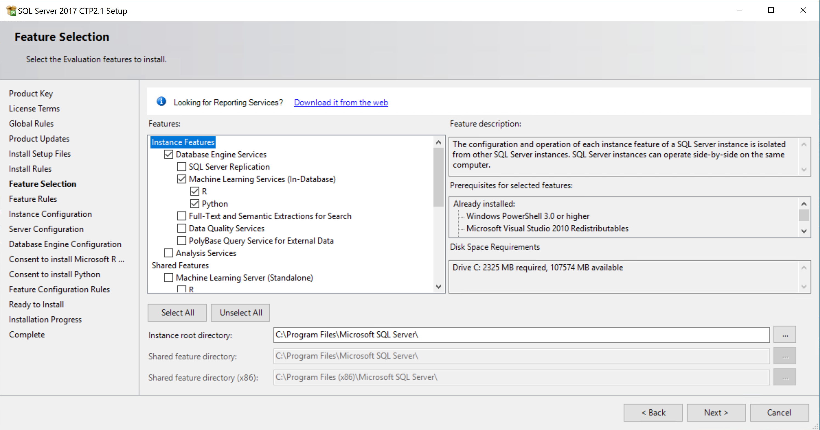
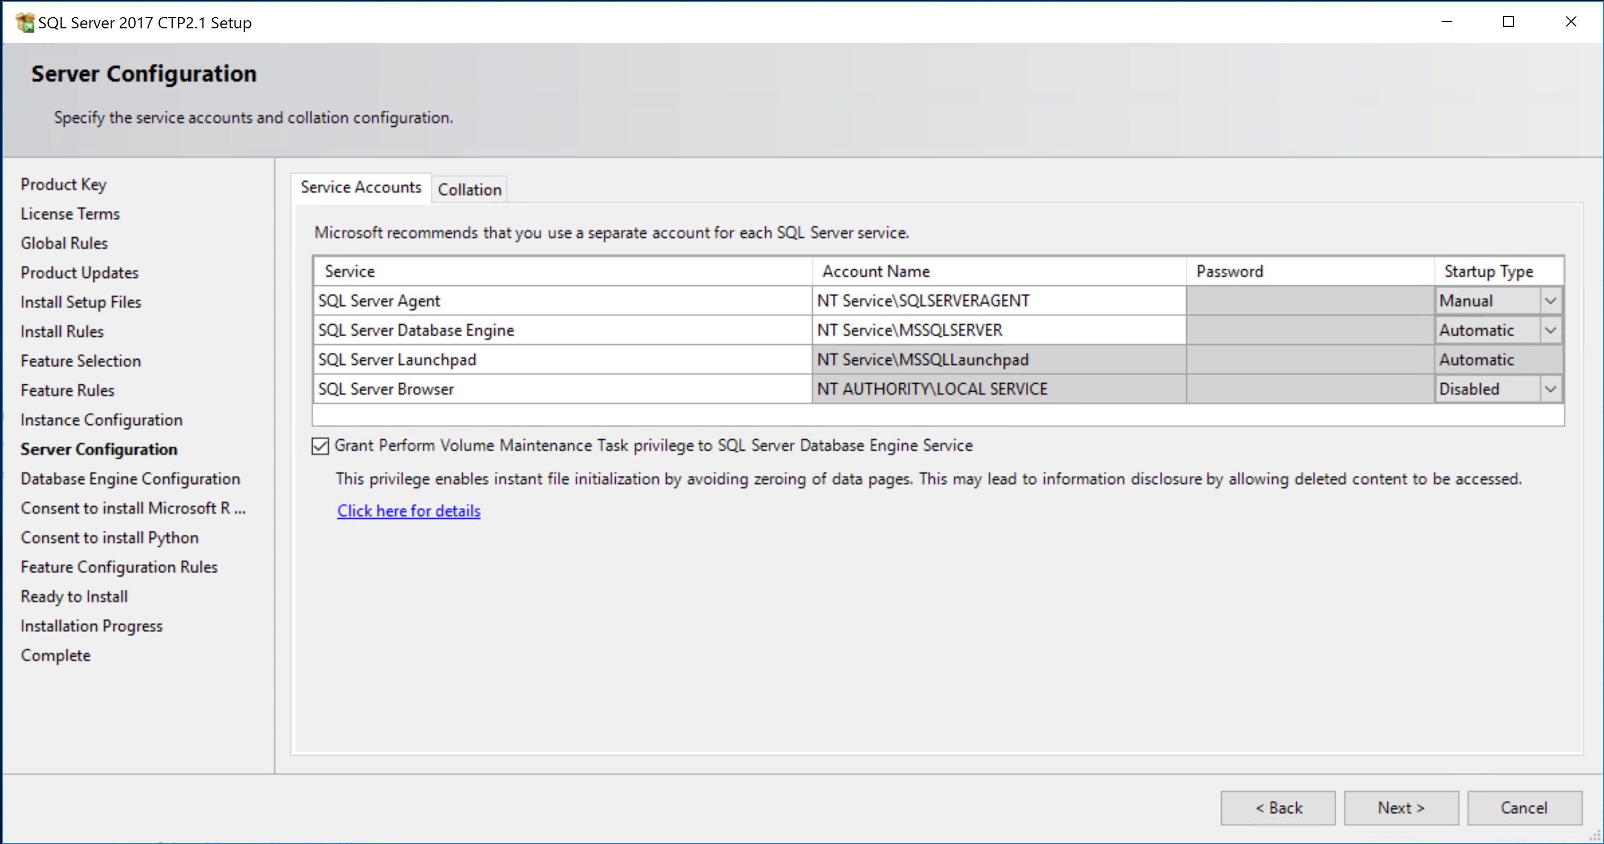
The Installer Experience
Considerations for Azure Virtual Machine
Not recommended to install both

Slide 21
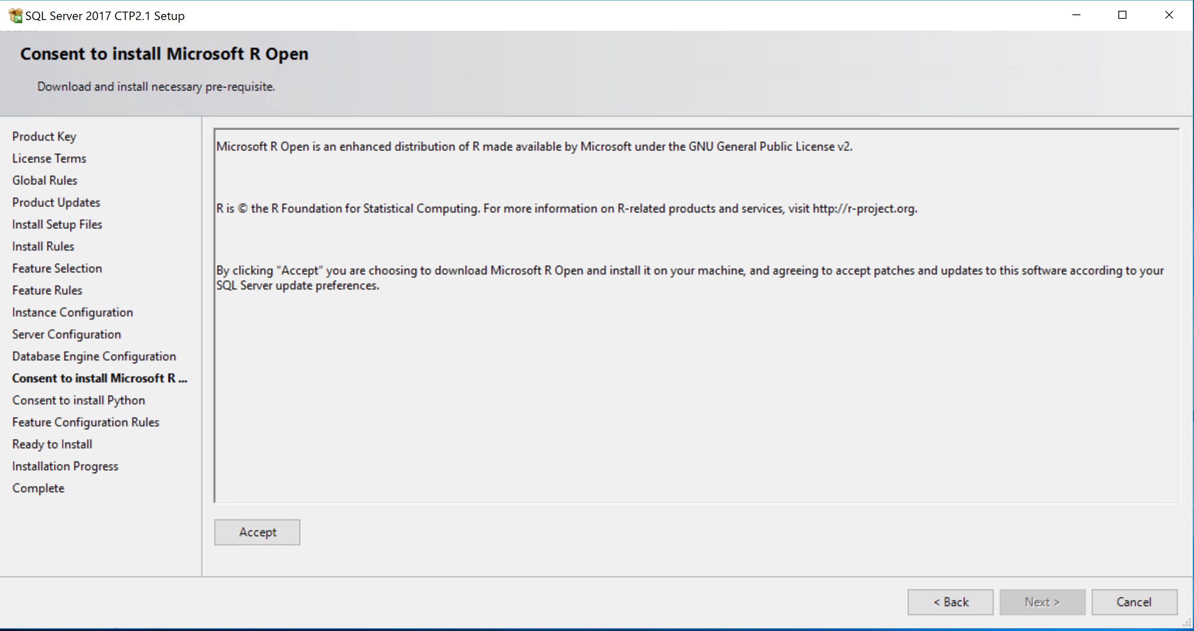
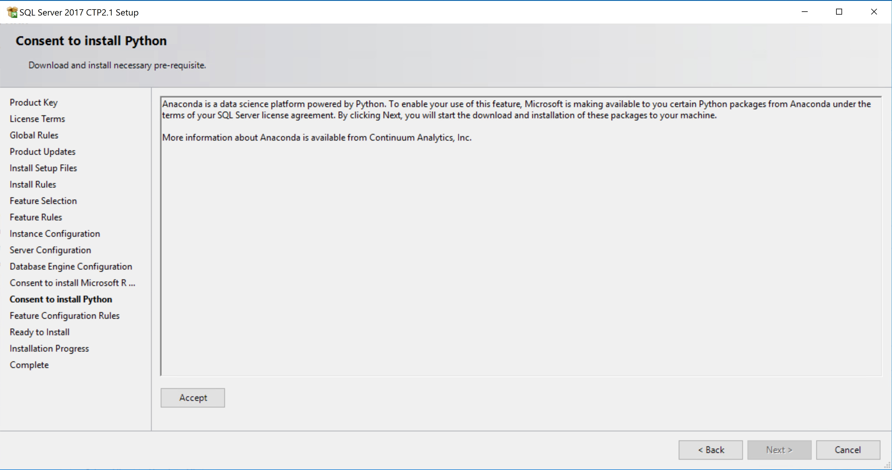
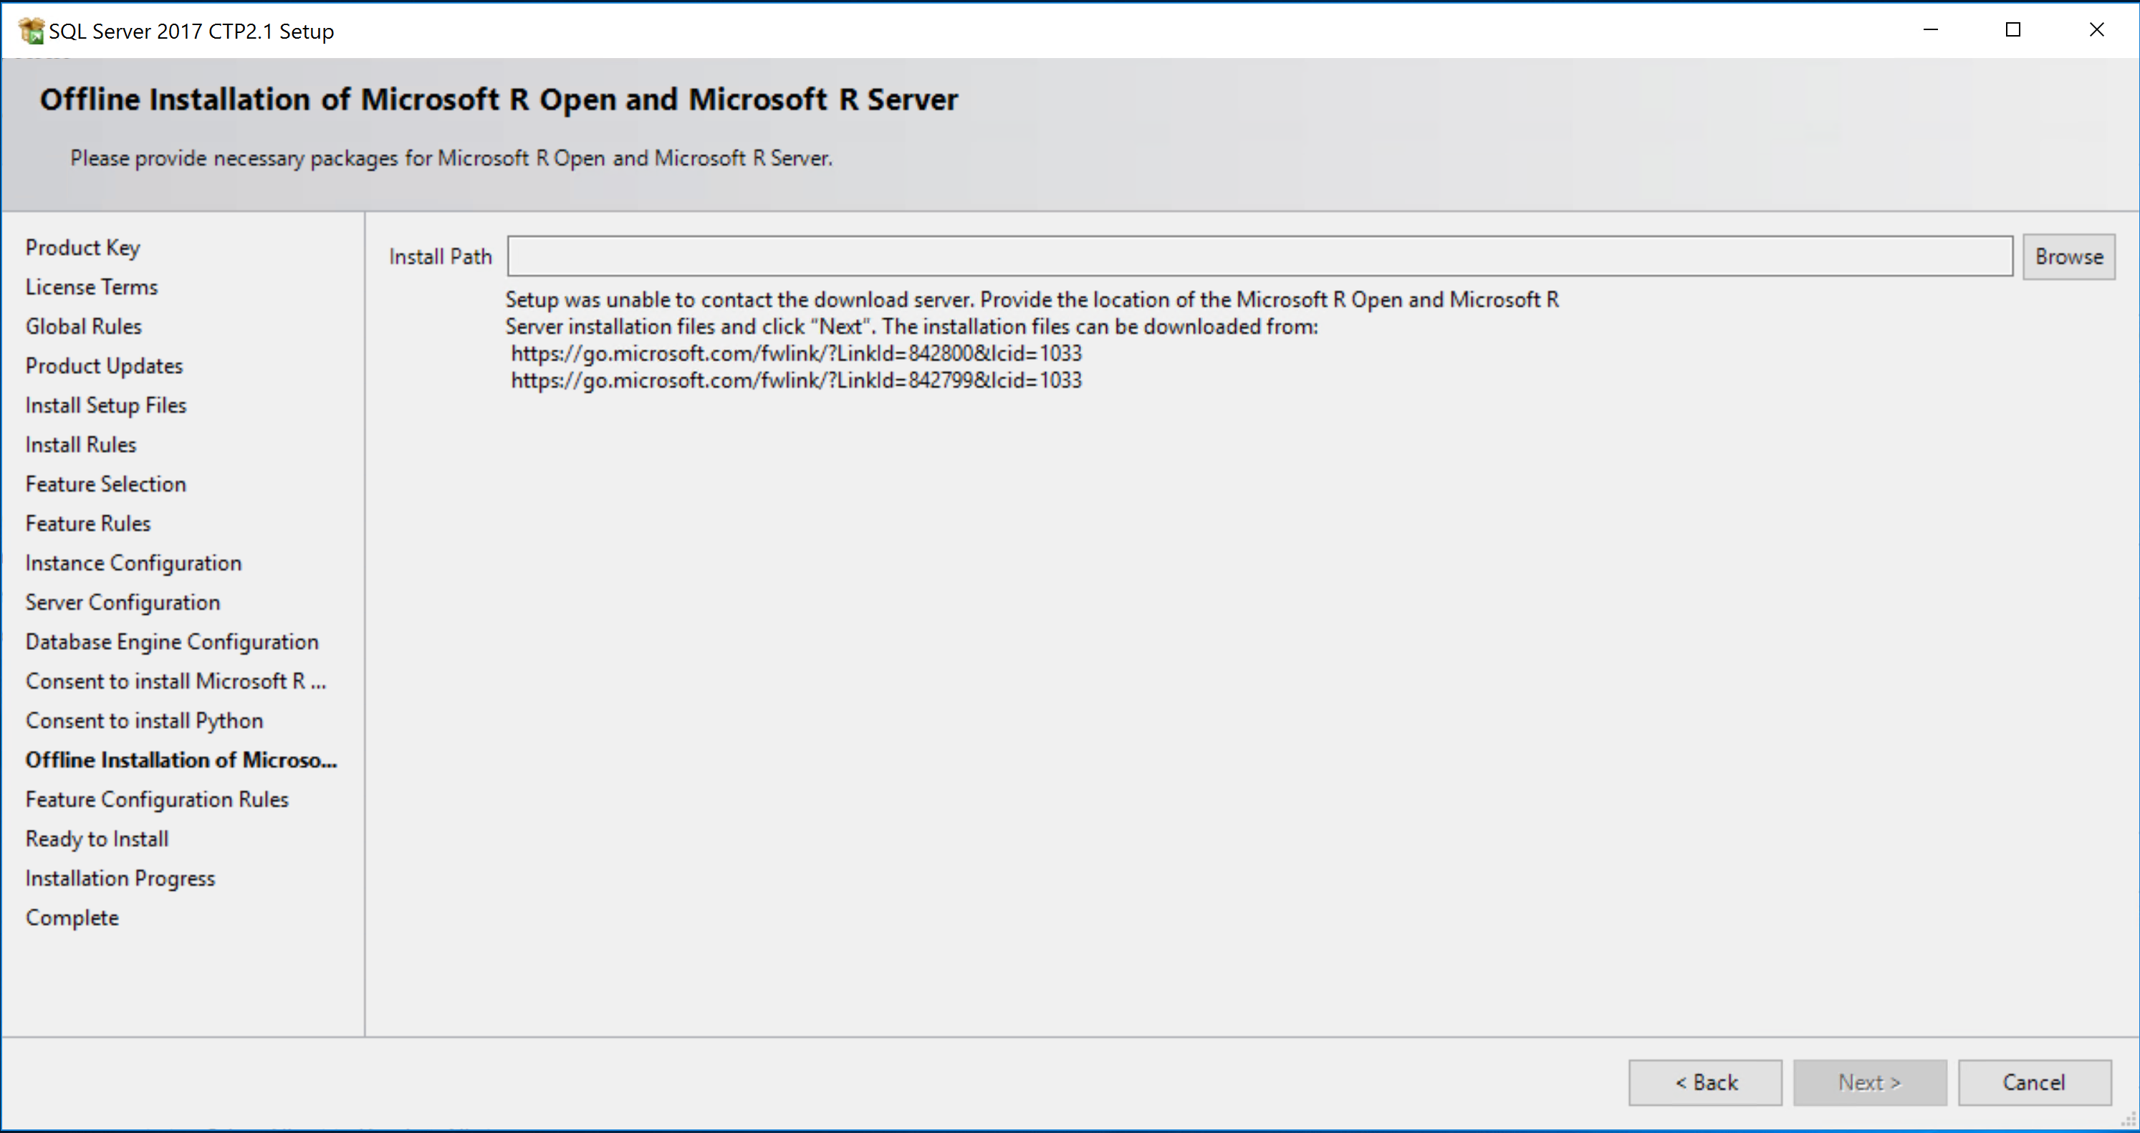
Consent and Download
The offline experience
CUs and SPs will have new download packages
Don’t forget /IACCEPTROPENLICENSETERMS and /IACCEPTPYTHONLICENSEAGREEMENT for unattended installs
Notes:
SQL Server 2017 CTP 2.1 has a bug where the offline experience does not work for Python. This will be fixed by RTM.

Slide 22

Demo
Just Show Us!
Notes:
Follow the instructions in demo1_justshowus\readme.txt

Slide 23
sp_execute_external_script
R Primer
Python Primer
Choices are ‘R’ or ‘Python’
execute sp_execute_external_script
@language = N'R'
, @script = N'
x <- as.matrix(InputDataSet);
y <- array(dim1:dim2);
OutputDataSet <- as.data.frame(x %*% y);'
, @input_data_1 = N'SELECT [Col1] from MyData;'
, @params = N'@dim1 int, @dim2 int'
, @dim1 = 12, @dim2 = 15
WITH RESULT SETS (([Col1] int, [Col2] int, [Col3] int, [Col4] int));
R dataframe or Python Pandas dataframe
script. Use a @var or read from a R file or Python file
Input data for script. Can be any T-SQL SELECT. Traceable
Parameters for script. OUTPUT supported. varbinary(max) used for trained models
Messages can also be returned including STDOUT and STDERR
Result set binding (Optional)
Supports any client that can run T-SQL
Notes:
sp_execute_external_script is an example of a special proc or specproc. The source code of the procedure can’t be found in the resource db. It is implemented in our source code
You technically don’t have to specify a query for input_data_set. You could run a R/Python script that just executes something and returns messages or returns a “result set” naturally.

Slide 24

The SQL Extensibility Architecture
Each SQL instance has a launchpad
MSSQLSERVER Service
MSSQLLAUNCHPAD Service
sqlservr.exe
launchpad.exe
Named pipe
sp_execute_external_script
“launcher”
“What” and “How”
to “launch”
SQLOS
XEvent
Run your “query”
Bxlserver.exe
Bxlserver.exe
Windows Satellite Process
sqlsatellite.dll
sqlsatellite.dll
sqlsatellite.dll
Notes:
Talk about other “extensible” environments we have used in the past
SQLCLR
xproc
sp_OA
Linked servers
Full-text

Slide 25
R/Python and SQL Server Together
Separate memory and CPU
Windows Job Object
This is all local!
process pool
conhost.exe
conhost.exe
Local User Account
low privileges
MSSQLSERVER Service
MSSQLLAUNCHPAD Service
rterm.exe
python.exe
Service SID
Service SID
Open R
python35.dll
sqlservr.exe
launchpad.exe
rlauncher.dll
R script
rxlink.dll
pylink.dll
sp_execute_external_script
rlauncher.dll
CreateProcess
pipe
CreateProcess –
named pipe
BxlServer.exe
pythonlauncher.dll
SQLOS
XEvent
ScaleR
compile input data query
Send message to pipe
Execute input query
Push results
Pull results
Python
script
pythonlauncher.dll
BxlServer.exe
SQLOS
XEvent
ScaleR
sqlsatellite.dll
interleaved
SNI/TCP – lower level comm (not TDS)
Retrieve input rows and params
Send back results and output params
stdout and stderr
sqlsatellite.dll
EXTERNAL_SCRIPT_NETWORK_IO wait
Local User Account
low privileges
“satellite” processes
Notes:
We deploy a “process pool” when launching scripts so when you run a script execution you will see more than one rterm/bxlserver pair. Since rterm is a windows console app you will also see a conhost.exe for each rterm.exe
Rterm = R runtime command interpreter
Python = Python command interpreter
Bxlserver = Microsoft R Server process which also hosts sqlsatellite.dll
Notes:
Memory requirements: SQL Server memory needed to run your query and any memory needed to process your data

Slide 26

Demo
Let’s Peek inside SQL Server Machine Learning Services
Notes:
Follow the instructions in insidesqlr\readme.txt
TODO: Show memory considerations for satellite processes based on queries
Put back in debugger to at least show SQL Server interleaved

Slide 27
SQL Server Machine Learning Services is Scalable
Enterprise Edition gives you the optimum scalability
More efficient than standalone clients
Data does not have to all fit in memory
Reduced data transmission over the network
Most R Open (and Python R) functions are single threaded
ScaleR and RevoScalePy APIs in scripts support multi-threaded processing on the SQL Server computer
We can stream data in parallel and batches from SQL Server to/from script
Use the power of SQL Server and ML to develop, train, and operationalize
SQL Server Compute Context (Remote Compute Context)
T-SQL queries
Memory-Optimized Tables
Columnstore indexes
Data compression
Parallel query execution
Stored procedures
It’s all about using the compute power of the server close to the data
Notes:
Perhaps the #1 reason why SQL ML Services is a value proposition is because we are pushing the computing power of SQL Server queries and R/Python scripts to the server leaving the client to analyze the results (such as plots)

Slide 28
SQL Server Machine Learning Services is Secure
Reduced surface area and isolation
‘external scripts enabled’ required
Script execution outside of SQL Server process space
Script execution requires explicit permission
sp_execute_external_script requires EXECUTE ANY EXTERNAL SCRIPT for non-admins
SQL Server login/user required and db/table access
Satellite processes has limited privileges
Satellite processes run under low privileged, local user accounts in the SQLRUserGroup
Each execution is isolated. Different users with different accounts
Windows firewall rules to block outbound traffic

Slide 29
External Resource Pools
Windows Job Objects
Each pool requires a separate job object
internal, default, “user”, and now external
Controls resources for external processes through Launchpad
Default external pool and user external pools. User classifier function supported
The controls
MAX_CPU_PERCENT – Max CPU percentage for external processes
MAX_PROCESSES – Max number of external processes
MAX_MEMORY – Max committed memory % for external processes
AFFINITY – Control NODEs or CPUs for external processes
This is independent of SQL Server worker threads.
dynamic
Min is 12 due to process pool. conhost.exe doesn’t count
% of computer physical memory.
Defaults are unlimited

Slide 30
Managing, Monitoring, and Troubleshooting
DMVs
dm_external_script_execution_stats – monitor R/Python script libraries
dm_external_script_requests – active script execution for R/Python
Perfmon counters: SQL Server:External Scripts
Extensibility LOGs and “launcher” LOGs in LOG\ExtensibilityLog directory
XEvents
Events for SQL Server, Launchpad, and external processes
Configuration file needed for Launchpad and external processes
procexp and procmon from sysinternals
Profiling R scripts
Python Profilers
Trace execution of sp_execute_external_script and “your query” to find diff

Slide 31
Pay Attention to These
SQL CAT Lessons Learned
Not supported on FCI (but works with AGs or Replication)
Windows Support Only (As of SQL Server 2017 CTP 2.1)
Script execution can be cancelled (may not absolutely immediate)
Launchpad needs specific privileges
Be sure SQLRUserGroup has Allow log on locally rights
Look to use T-SQL to replace script logic (Ex. GROUP BY)
SQL Server Query and Index design still apply
Scripts can often benefit from tuning
Apply latest SQL Server 2016 updates

Slide 32
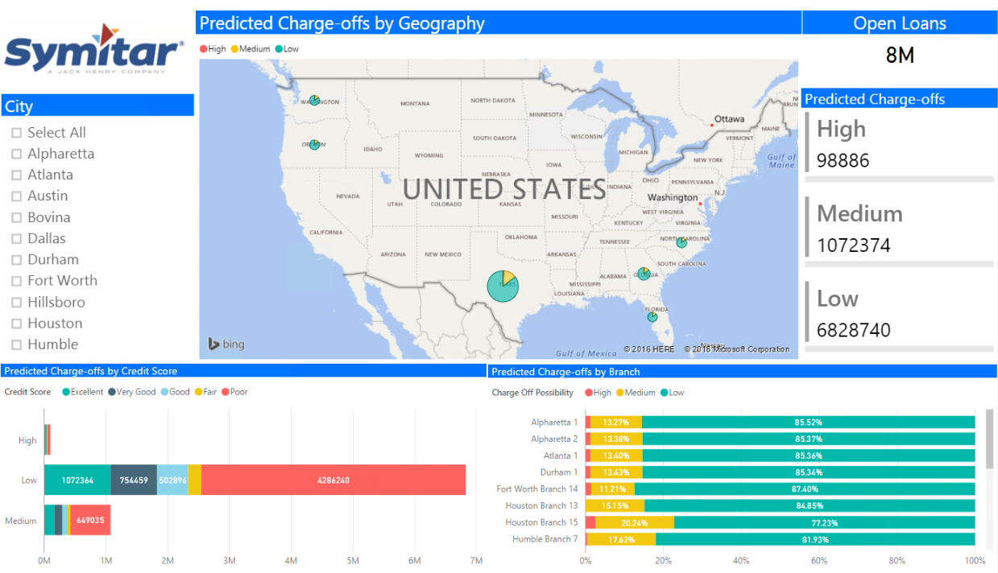
SQL Server and Machine Learning @ Scale
Jack Henry A leading provider for banking solutions for credit unions across Americas
Business User
20M Vehicle Loans
1 million predictions per second using SQL-R
Age, Original Balance, Interest Rate, Loan Remaining Months, Credit Score
R
Store
Predictions
Visualize
ColumnStore
In-Database Analytics at Scale
In-memory OLTP
PowerBI Dashboard
Prepare for analytics

Slide 33

Demo
This stuff really works!
Notes:
TODO: Will we have time for this?

Slide 34
What is New for SQL Server 2017
Python Support (including new revoscalepy library)
Distributed models in parallel
R Script Package Management
The MicrosoftML package included
“Native” scoring with T-SQL PREDICT (coming soon)
Upgrading R Components

Slide 35
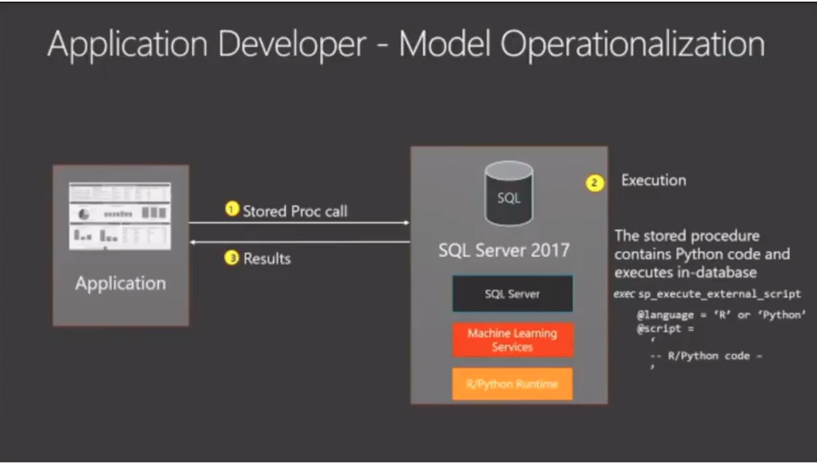

Slide 36
R Integration with SQL Server – SQL Server Compute Context
sqlCompute <- RxInSqlServer(connectionString = sqlConnString, wait = TRUE, consoleOutput = TRUE)
rxSetComputeContext("sqlCompute")
R Client
rterm.exe
Open R
sqlservr.exe
rterm.exe
rxlink.dll
RODBC
launchpad.exe
sp_execute_external-script
CreateProcess
pipe
BxlServer.exe
BxlServer.exe
sqlsatellite.dll

Slide 37
Best Practices and Performance Considerations
docs recommend min 32Gb
Computer with enough cores, memory, and disk speed
High Performance Power Option
Balance memory needed by SQL Server and external pool
Launchpad needs specific privileges
Be sure SQLRUserGroup has log on local rights
Restart the SQL Server Service not stop/start (Launchpad is dependent)
8dot3 notation needs to be enabled. Read more here
Remote ODBC execution requires SQLRUserGroup login
20 unique users allowed to execute scripts concurrently by default
SQL Server Query and Index design still apply
Scripts can often benefit from tuning
Default max memory is 20% of RAM
Need to add more?
Notes:
TODO: Modify this one

Slide 38
The SQL Server R Lifecycle
Encapsulate in a stored procedure
R Client
Migrate to ScaleR
SQL Compute Context
Some R scripts to T-SQL
Install R Services (In Database)
Develop model
Train and save model
Operationalize the model
Tune and configure for production
Enable and verify
SQL query tuning
R script tuning
Batch size
Resource Governor
sp_execute_external_script
sp_configure
“hello world test”
Notes:
Possible cut slide

Slide 39
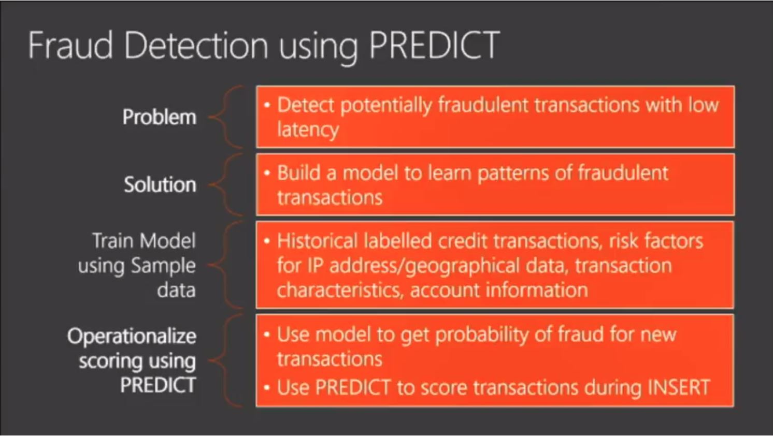

Slide 40
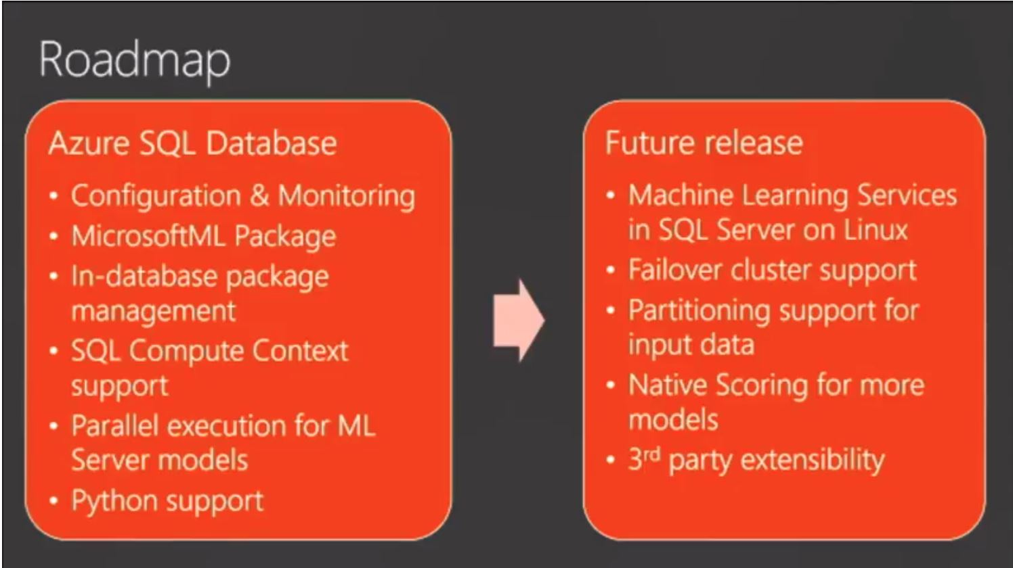

Slide 41
In review: session objectives and takeaways
At the end of this session, you should be
better able to…
Learn the basics of SQL Server Machine Learning Services from the perspective of a SQL Server Professional
Understand how SQL Server Machine Learning Services works behind the scenes to provide more confidence to deploy in an Enterprise Environment
SQL Server Machine Learning Services is Secure, Scalable, and Familiar
SQL Server 2016 and 2017 provide a new extensible database intelligence platform

